Slide 1
PERSON IDENTIFICATION SYSTEM USING MACHINE LEARNING
Presented By:
Group – 4
Pawan Kumar Thapa (20155032)
Aman Agarwal (20155066)
Deepanjan Saha (20152048)
Under the guidance of
Prof. Haranath Kar
DEPARTMENT OF ELECTRONICS AND COMMUNICATION ENGINEERING
MOTILAL NEHRU NATIONAL INSTITUTE OF TECHNOLOGY ALLAHABAD
PRAYAGRAJ-211004, INDIA

Slide 2
CONTENT
INTRODUCTION
MOTIVATION
DATASET
WORK PLAN
WORK DONE
RESULTS
FUTURE SCOPE
TOOLS/RESOURCES USED
REFERENCES

Slide 3
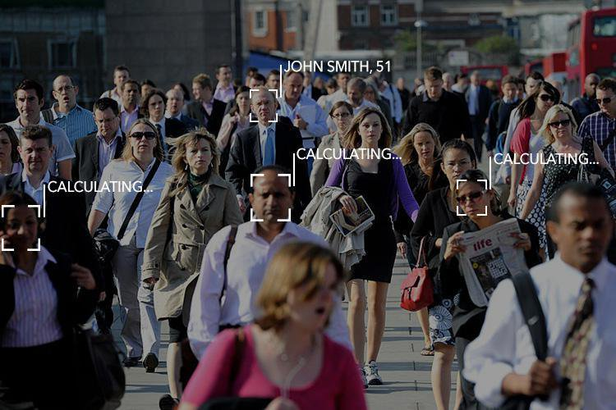
INTRODUCTION
A person identification system is a technology capable of identifying or verifying a person from a digital image or a video frame from a video source.
There are multiple methods in which these systems work, but in general, they work by comparing selected facial features from given image with faces within a database.
It is also described as a Biometric Artificial Intelligence based application that can uniquely identify a person by analysing patterns based on the person's facial textures and shape.

Slide 4
MOTIVATION
The main motivation behind pursuing this project is that it can solve following real life problem:
The proposed system can be effectively used in simplifying the process of Attendance by eliminating the need of any biometric devices like fingerprint or retina scanner with just a digital camera. This will reduce the costs considerably and simplify the process of attendance.
This system can also be used for tracking a suspect/criminal or for surveillance of dangerous individuals and can help to improve security.
It has wide range applications in security including security of our personal electronic devices like smartphones, laptops, PCs, etc. It can considerably improve the personal safety of an individual.

Slide 5
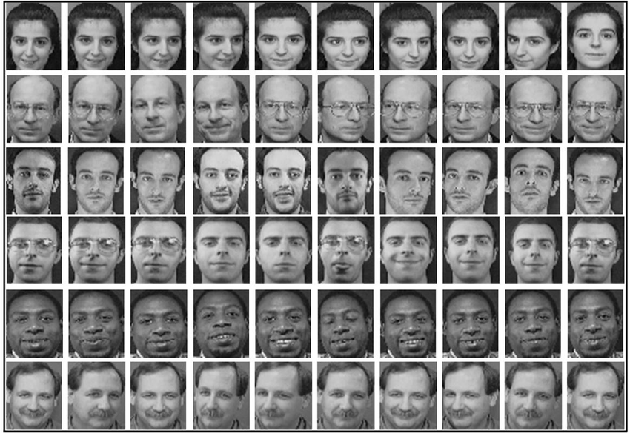
DATASET USED
Cambridge ORL Database
For the training, we use the Cambridge ORL face database, which consists of 400 images of 40 individuals, containing quite a high degree of variability in expression, pose, and facial details.

Slide 6
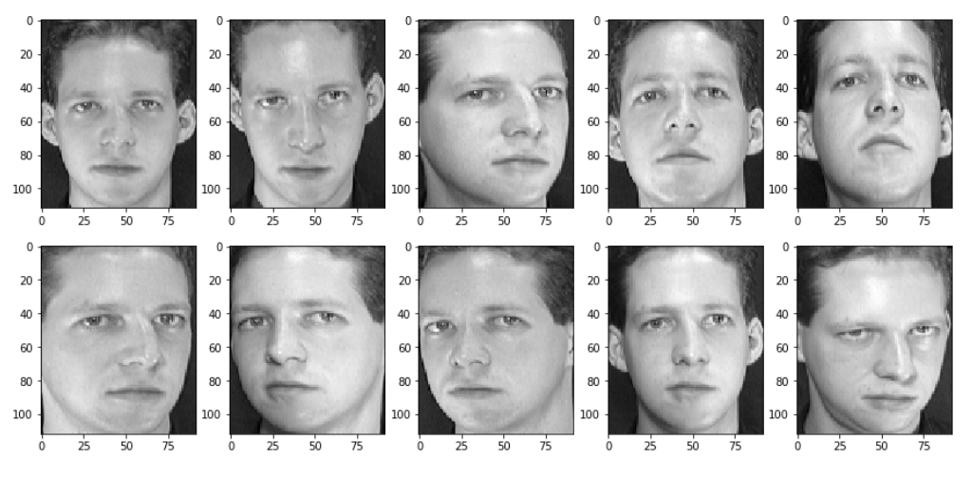
SAMPLE IMAGES FROM ORL DATABASE
Fig: All Images of First person in the ORL Database

Slide 7
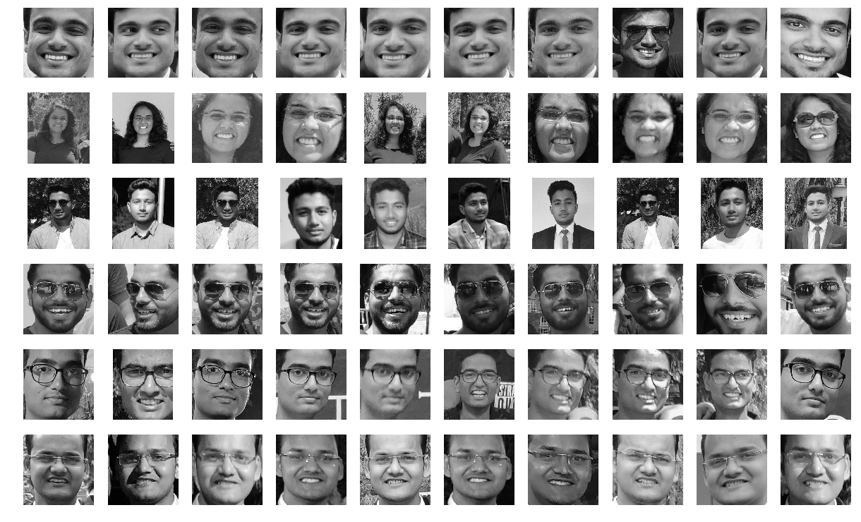
DATASET USED
MNNIT Faces Database
For the testing and ensuring that the database works for normal images with multiple faces we created an extended database of students of MNNIT from ECE 2019 Batch. It currently consists of 45 Students with 20 images for each student in various angles, lighting conditions etc.

Slide 8
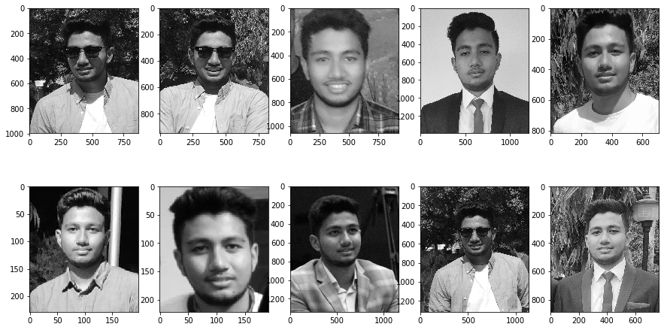
SAMPLE IMAGES FROM MNNIT Faces
Fig: 10 Images of Pawan Kumar Thapa from MNNIT Faces Database

Slide 9
WORK PLAN

Slide 10
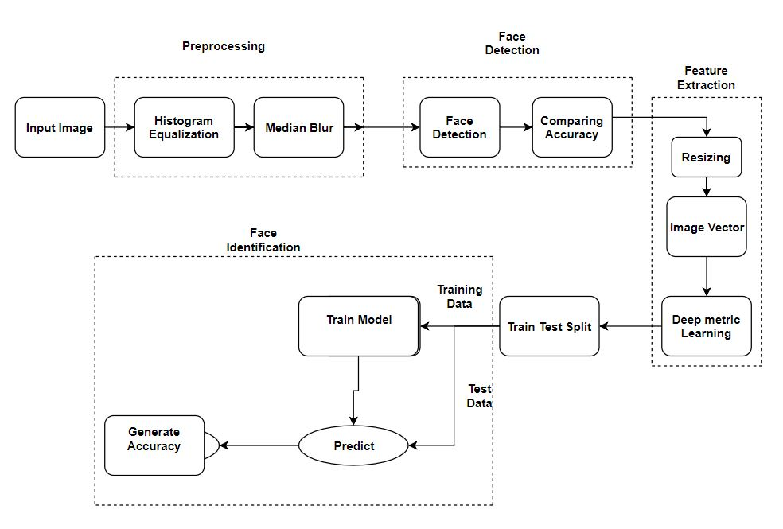
WORKFLOW

Slide 11
PHASE 1
(Face Detection)

Slide 12
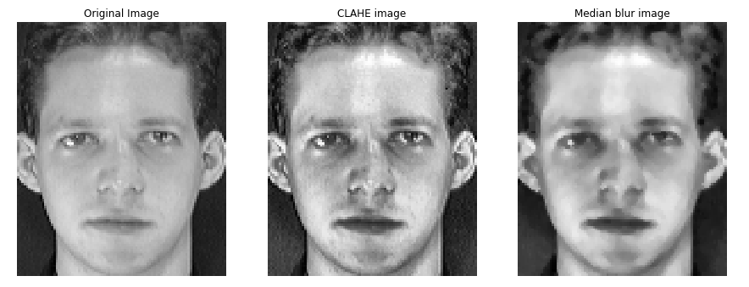
PREPROCESSING
To increase the detection probability of face, we apply some basic Preprocessing methods.
Histogram Equalization (specifically: Contrast limited adaptive histogram equalization (CLAHE)): This is used to increase the contrast between face and the background in a controlled manner.
Median Blur: The CLAHE output induces Salt and pepper noise, which is effectively reduced by applying Median filter on the result.

Slide 13
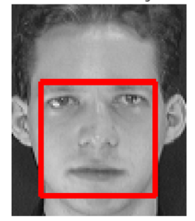
FACE DETECTION
Face Detection Objective:
Finding the faces (of any size) in an image.
Probably extract them to be used by the face recognition algorithm.
In this project we make use of one of the oldest and more popular face recognition algorithms: Local Binary Patterns Histograms (LBPH).
Local Binary Pattern (LBP) is a simple yet very efficient texture operator which labels the pixels of an image by thresholding the neighbourhood of each pixel and considers the result as a binary number.

Slide 14
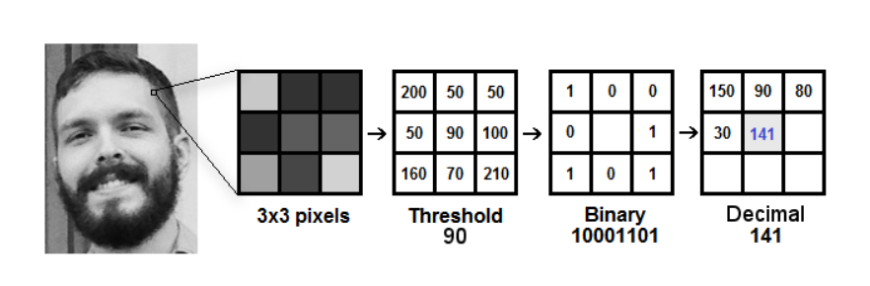
FACE DETECTION
Step By Step LBP operation:
The first computational step of the LBPH is to create an intermediate image that describes the original image in a better way, by highlighting the facial characteristics.
To do so, the algorithm uses a concept of a sliding window, based on the parameters radius and neighbors.

Slide 15
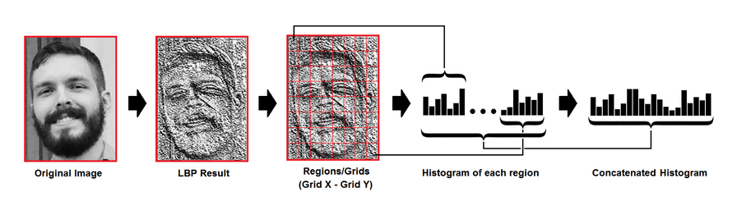
FACE DETECTION
Now, using the image generated in the last step, we can use the Grid X and Grid Y parameters to divide the image into multiple grids, as can be seen in the following image.

Slide 16
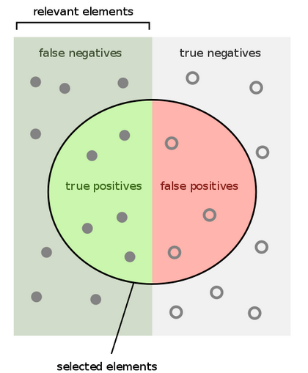
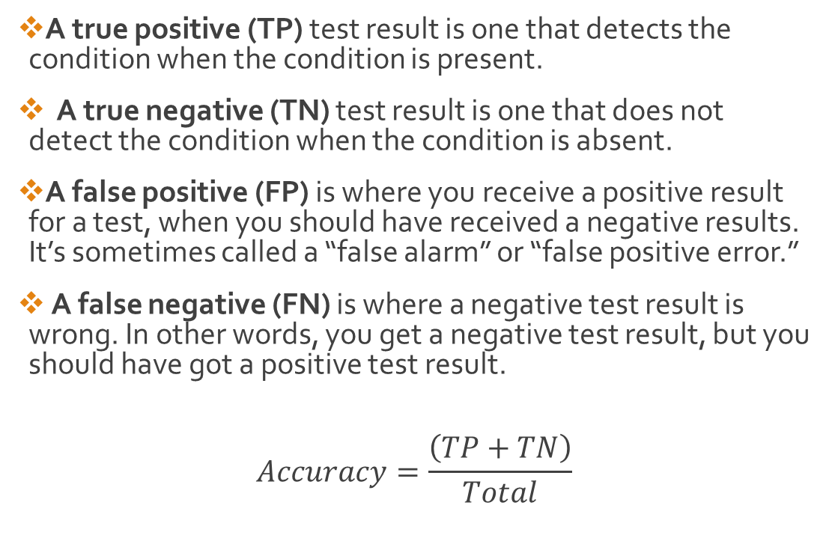
FACE DETECTION (ACCURACY)
A true positive (TP) test result is one that detects the condition when the condition is present.
A true negative (TN) test result is one that does not detect the condition when the condition is absent.
A false positive (FP) is where you receive a positive result for a test, when you should have received a negative results. It’s sometimes called a “false alarm” or “false positive error.”
A false negative (FN) is where a negative test result is wrong. In other words, you get a negative test result, but you should have got a positive test result.
$$Accuracy=\frac{\left(TP+TN\right)}{Total}$$

Slide 17
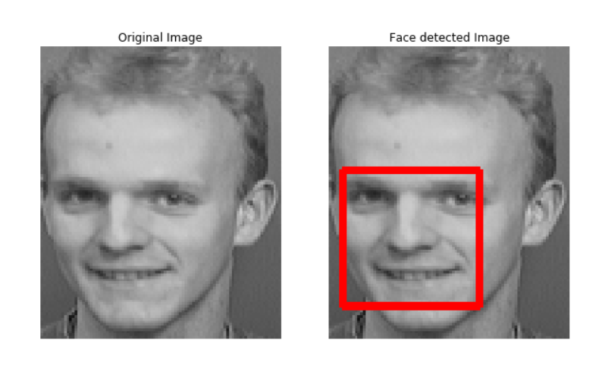
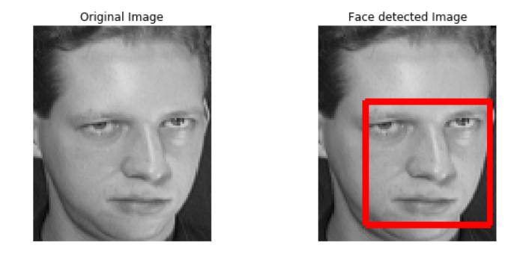
FACE DETECTION (RESULTS IN IMAGE)

Slide 18
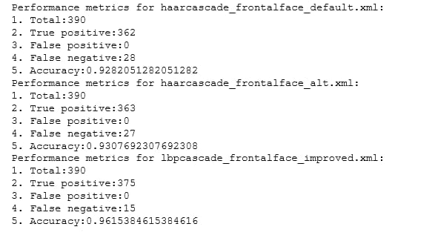
FACE DETECTION (RESULTS)

Slide 19
FACE DETECTION (RESULTS)
Algorithm | True Positive | False Positive | False Negative | Accuracy
Haar Cascade | 362 | 0 | 28 | 92.82%
Haar Cascade Improved | 363 | 0 | 27 | 93.07%
Lbp Cascade | 375 | 0 | 15 | 96.15%

Slide 20
PHASE 2
(Face Identification)

Slide 21
FEATURE EXTRACTION
After the completion of face detection we apply the process of feature extraction by extracting the pixel intensity value of each pixel in the face detected image.
Consequently that image is converted to a vector. For e.g. If the Face detected image has the size of 50 x 50 then the corresponding feature vector has the dimensions of 1 x 2500.
The Image vector thus created, is passed through a Convolutional Neural Network (CNN), results into 128 element feature vector. This is called “Deep Metric Learning”.

Slide 22
TRAINING THE MODEL
5 classification models were trained on Cambridge ORL Dataset, namely Naïve Bayes, Random Forest, Decision Tree, Support Vector Machine (SVM) and Logistic Regression.
The corresponding accuracies are:
Training Model | Accuracy Obtained
Naïve Bayes | 88.46%
Logistic Regression | 97.43%
Decision Tree | 56.41%
Random Forest | 91.02%
Support Vector Machine | 97.43%

Slide 23
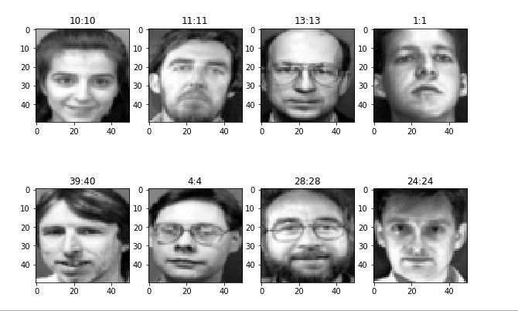
SAMPLE TEST IMAGES (Naïve Bayes)
Fig: Results for Naïve Bayes model

Slide 24
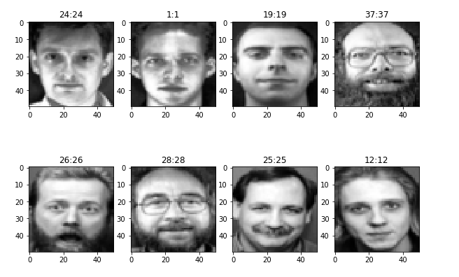
SAMPLE TEST IMAGES (Logistic Regression)
Fig: Results for Logistics Regression

Slide 25
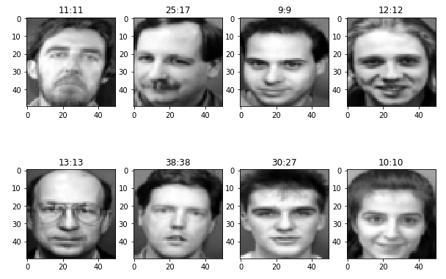
SAMPLE TEST IMAGES (Decision Tree)
Fig: Results for Decision Tree

Slide 26
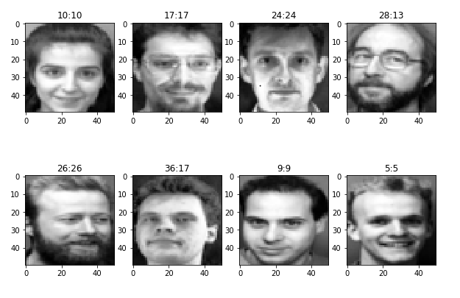
SAMPLE TEST IMAGES (Random Forest)
Fig: Results for Random Forest

Slide 27
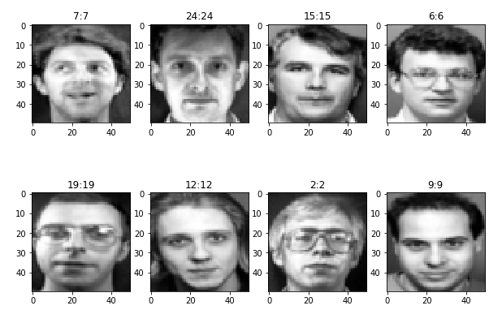
SAMPLE TEST IMAGES (SVM)
Fig: Results for Random Forest

Slide 28
PHASE 3
(MNNIT DATASET)

Slide 29
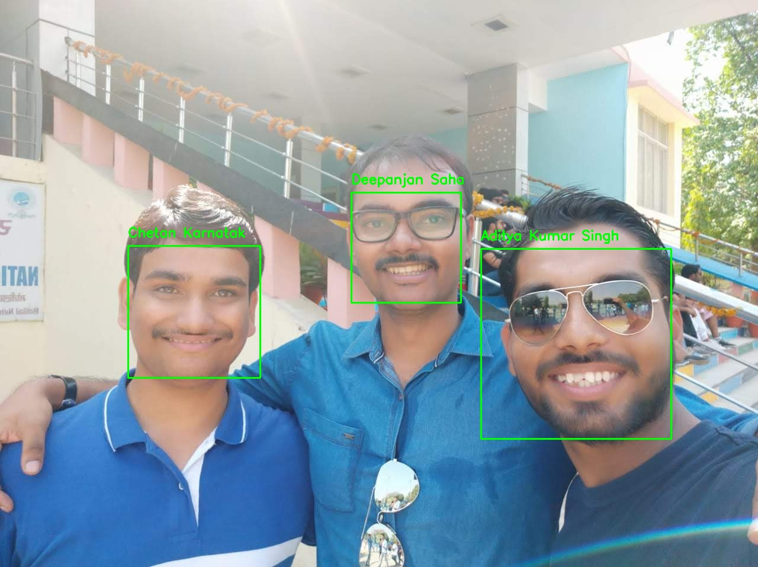
Testing on MNNIT Faces Database
After training our model and getting good accuracy for the Cambridge ORL Dataset we trained our algorithm on MNNIT Faces Database.
The Algorithm worked pretty well for the images taken from various events with multiple faces in it.
The training images were taken from Informal Photoshoot and Rukhsat while the testing was done on the images taken during the Formal Photoshoot of the batch.
While testing we found that the accuracy was about 95%.

Slide 30
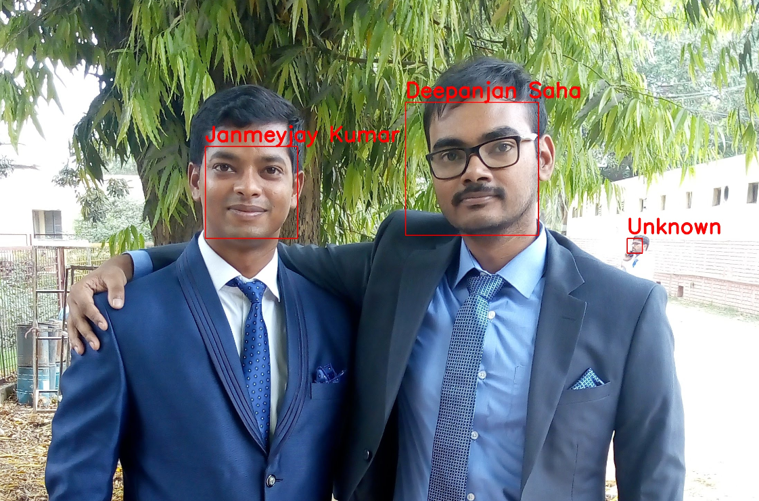
RESULTS FROM MNNIT Faces Database

Slide 31
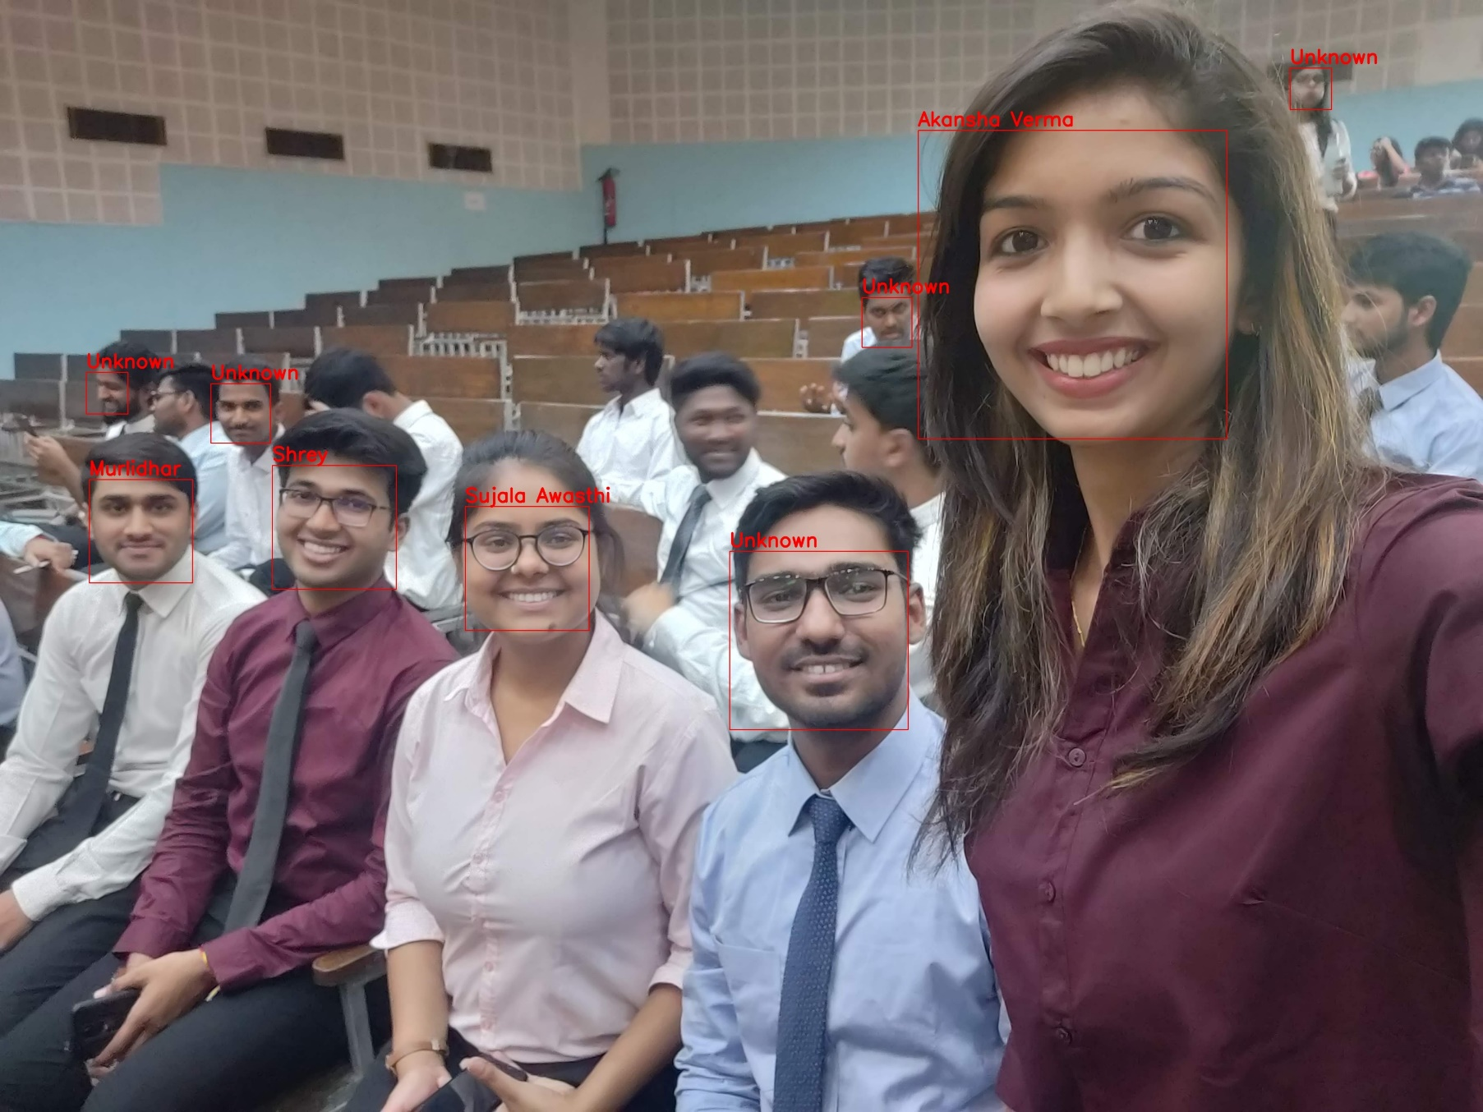

Slide 32
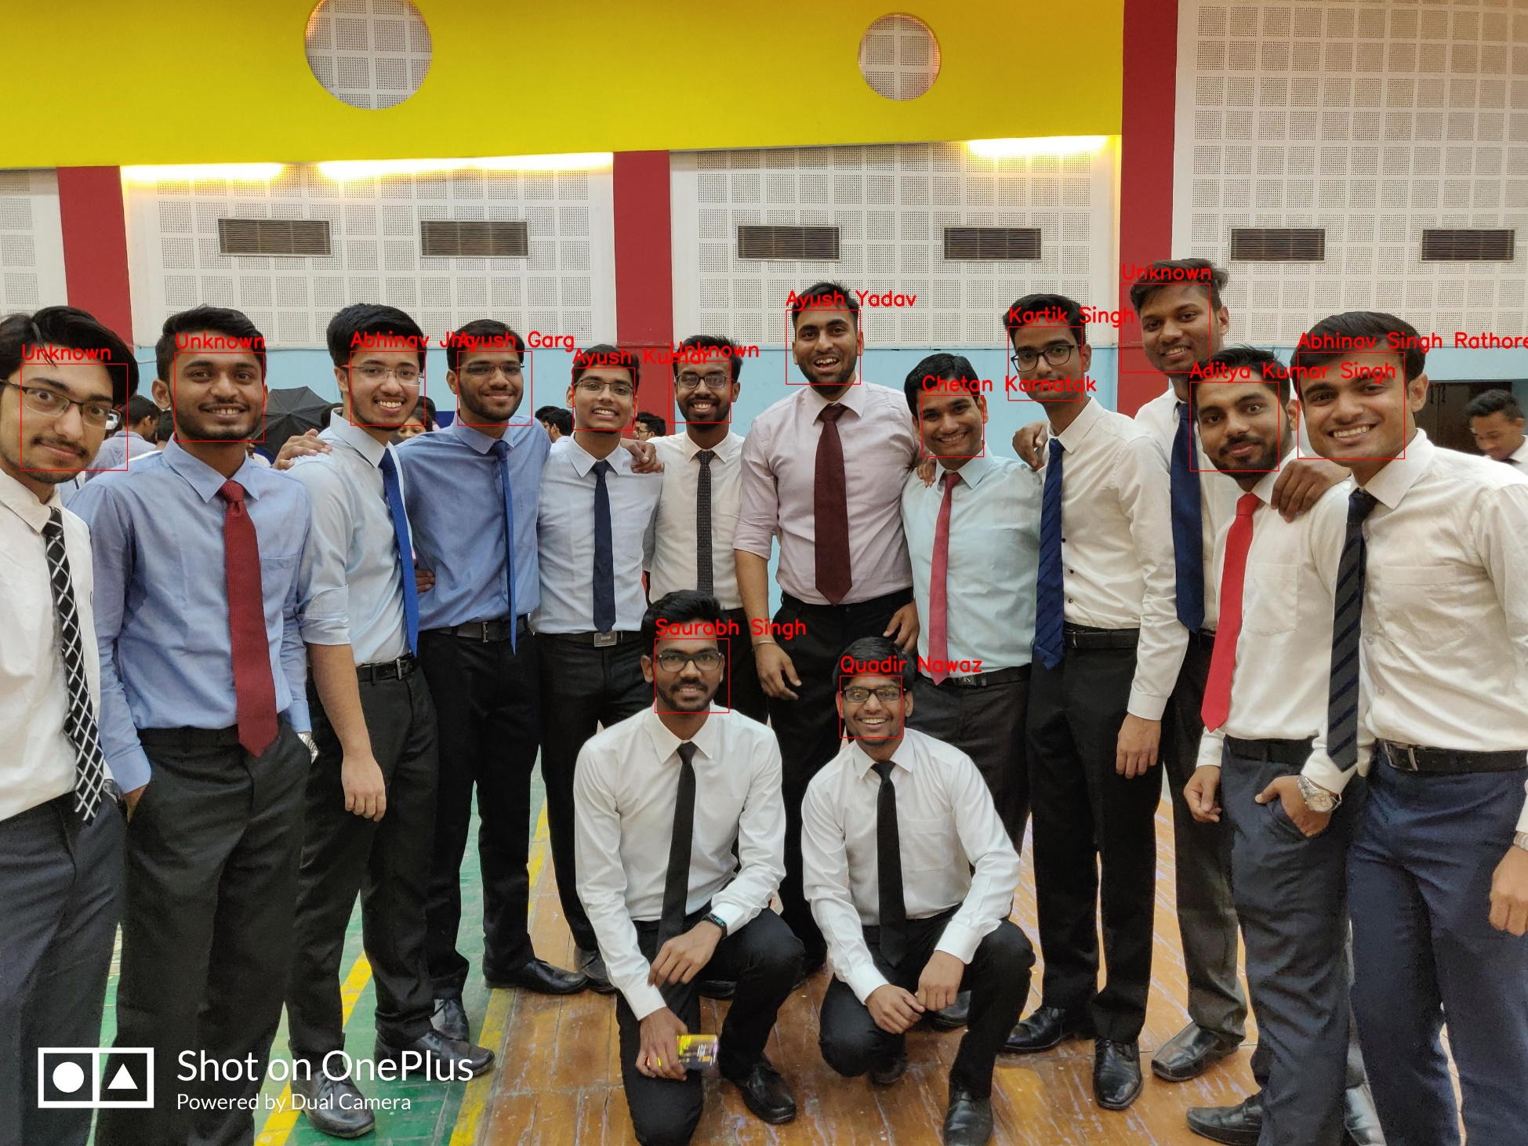

Slide 33
FUTURE SCOPE
Designing a GUI based system for the proposed algorithm and making it usable for the people.
Implement face identification from live video feed.
Developing an App for the same algorithm so as to increase the reach and make it much more usable.

Slide 34
TOOLS USED
Hardware Used:
Webcam for input images
Software Used:
OpenCV for image processing, saving files.
Matplotlib for plotting multiple images.
Sklearn for implementing ML algorithms.
Google Colab for training the data.
Pycharm IDE

Slide 35
REFERENCES
[1] Zhen, Chenggang, and Yingmei Su. "Research about human face recognition technology." Test and Measurement, 2009. ICTM'09. International Conference on. Vol. 1. IEEE, 2009.
[2] Guo, Guodong, Stan Z. Li, and Kapluk Chan. "Face recognition by support vector machines." Automatic Face and Gesture Recognition, 2000. Proceedings. Fourth IEEE International Conference on. IEEE, 2000.
[3] Viola, Paul, and Michael Jones. "Rapid object detection using a boosted cascade of simple features." Computer Vision and Pattern Recognition, 2001. CVPR 2001. Proceedings of the 2001 IEEE Computer Society Conference on. Vol. 1. IEEE, 2001.
[4] Amaro, E. Garcia, Marco Aurelio Nuño-Maganda, and Miguel Morales-Sandoval. "Evaluation of machine learning techniques for face detection and recognition." CONIELECOMP 2012, 22nd International Conference on Electrical Communications and Computers. IEEE, 2012.

Slide 36
THANK YOU

